Slide 1
Introduction to Supervised Machine Learning

Slide 2
Characteristics of Supervised Machine Learning -
Class of machine learning algorithms that work on externally supplied instances (data) in form of predictor attributes and associated target values
They produce a model in form of equations or likelihood ratios or rules representing alternate hypothesis i.e. distribution of class labels in terms of predictor
The model thus generated is used to make predictions about future instances where the predictor feature values are known but the target / class value is unknown
E.g.-1 building model to predict the re-sale value of a car based on its current mileage, age, color etc.
E.g.-2 Predicting the final year scores based on student performance in previous years.

Slide 3
Supervised Machine Learning Steps -
Identify Data Required
Identify what type of data, source of data and how to ingest data into your system. Need domain expertise and lateral thinking
Pre-process
Data
Address data quality issues such as missing values, outliers, data pollution etc. Establish veracity of the data. Need domain expertise
Create training & test set
Split the data into training set and test set. Generally 70:30 ratio is used
Select appropriate algorithm/s
Select appropriate algorithm/s to model. For e.g. Random Forest, K Nearest Neighbors etc. Depends on data
Train & build the model
Build the model in Python or Spark or R
Evaluate with test data
Evaluate the model on test data ensure it is not overfit or underfit
OK?
Deploy at scale
No
Yes

Slide 4
The Supervised Machine Learning is broadly classified into -
Regression based supervised learning - concerned with modeling the relationship between variables. For e.g. linear regression and logistic regression
Instance-based learning model is a decision problem with instances or examples of training data that are considered. For e.g. K Nearest Neighbors
Algorithm based models such as Decision Trees, Naïve Bayesian classifiers
Regularization Algorithms- An extension to regularization method that penalizes models based on their complexity, favoring simpler models that are also better at generalizing. (Not covered in this training)

Slide 5
Types of Probabilistic Models

Slide 6
Regression Model
Relationship between one dependent variable and explanatory variable(s)
Use equation to set up relationship
Numerical Dependent (Response) Variable
1 or More Numerical or Categorical Independent (Explanatory) Variables
Used Mainly for Prediction & Estimation

Slide 7
Types of Regression Models
1 Explanatory
Variables
Regression
2+ Explanatory
Variables
Models
Simple
Multiple
Non-
Non-
Linear
Linear
Linear
Linear
Notes:
24
This teleology is based on the number of explanatory variables & nature of relationship between X & Y.

Slide 8
Linear Regression

Slide 9
Types of Regression Models
1 Explanatory
Variables
Regression
2+ Explanatory
Variables
Models
Simple
Multiple
Non-
Non-
Linear
Linear
Linear
Linear
Notes:
24
This teleology is based on the number of explanatory variables & nature of relationship between X & Y.

Slide 10
Prediction Method
Method | No. of independent variables | No. of dependent variables | Type of Dependent variable
Simple linear Regression | 1 | 1 | Real
Multiple Linear Regression | > 1 | 1 | Real
Logit Regression | >1 | 1 | Real / Categorical
Artificial Neural Network | >1 | >1 | Real / Categorical

Slide 11
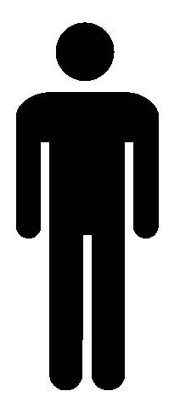
Simple Linear Regression
Simple Linear regression models are used to show or predict the relationship between two quantitative Variables.
Data can be Visualized using Scatter Plot.
Linear Regression is a where your relationship between 2 variables can be represented by a straight line
in
Kg
Kg

Slide 12
Types of variable in Regression
Dependent Variable
Independent Variable

Slide 13
Dependent variable
A dependent variable is what you measure in the experiment and what is affected during the experiment. The dependent variable responds to the independent variable. It is called dependent or response variable.
e,g. Weight of a person depends on his/her Height. In this case Weight is a dependent variable

Slide 14
Independent Variable
An independent variable, sometimes called an experimental or predictor variable, is a variable that is being manipulated in an experiment in order to observe the effect on a dependent variable, sometimes called an outcome variable or exploratory Variable.
Eg. Height, gender is a independent variable
Note : if its only one exploratory variable then its called as simple linear regression

Slide 15

Example 1
Is it possible to do this prediction ?
Predict weight(Y variable) of a person based on his/her age ?
Dependent Variable (X) - Weight
Independent or
responsive Variable (Y) - Age
Note : Since the independent Variable is restricted to one variable, this method of regression is called as Simple Linear Regression

Slide 16
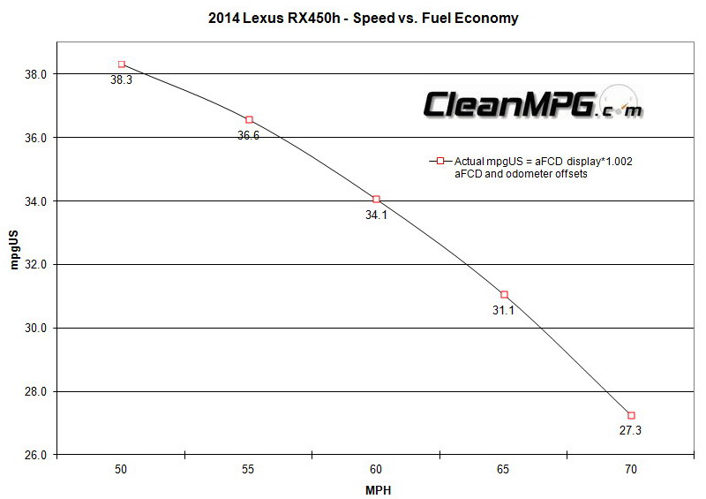
Example 2
Driving speed and gas mileage
As driving speed increases, you'd expect gas mileage to decrease, but not perfectly.

Slide 17
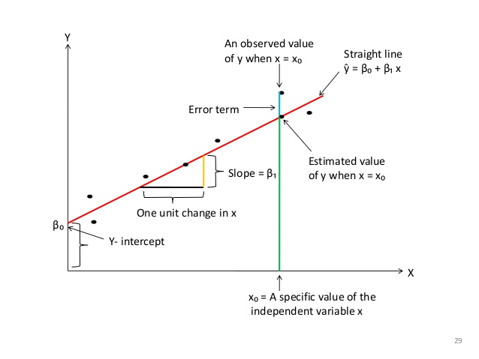
First Ordinary Linear Model
y = dependent variable
x = independent variable
β₀ = y-intercept
β₁ = slope of the line
ε = error variable

Slide 18
Best Fit Line
Question: What should be considered a good line?
y
w
w
w
w
w
w w w w
w
w w
w w
w
x

Slide 19
Identify the best fit line ?
A good line is one that minimizes the sum of squared differences between the
points and the line.
y
w
w
w
w
w
w w w w
w
w w
w w
w
x

Slide 20
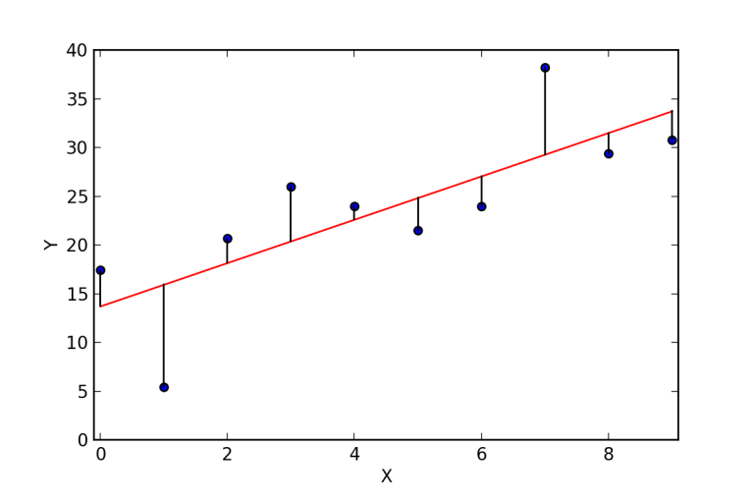
Identify the Best Fit Line
Purpose of best fit line is that our predicted values should be closer to our actual or the observed values and not far away from the real values.
Tend to minimize the difference between the values predicted and the observed values, and which is actually termed as error.
These errors are also called as residuals. The residuals are indicated by the vertical lines showing the difference between the predicted and actual value.
Aim is to reduce the error/residuals

Slide 21
Estimating Parameters: Least Squares Method

Slide 22
Ordinary Least Square Example
Restaurant | 1 | 2 | 3 | 4 | 5 | 6 | 7 | 8 | 9 | 10
Population | 2 | 6 | 8 | 8 | 12 | 16 | 20 | 20 | 22 | 26
Sales | 58 | 105 | 88 | 118 | 117 | 137 | 157 | 169 | 149 | 202

Slide 23
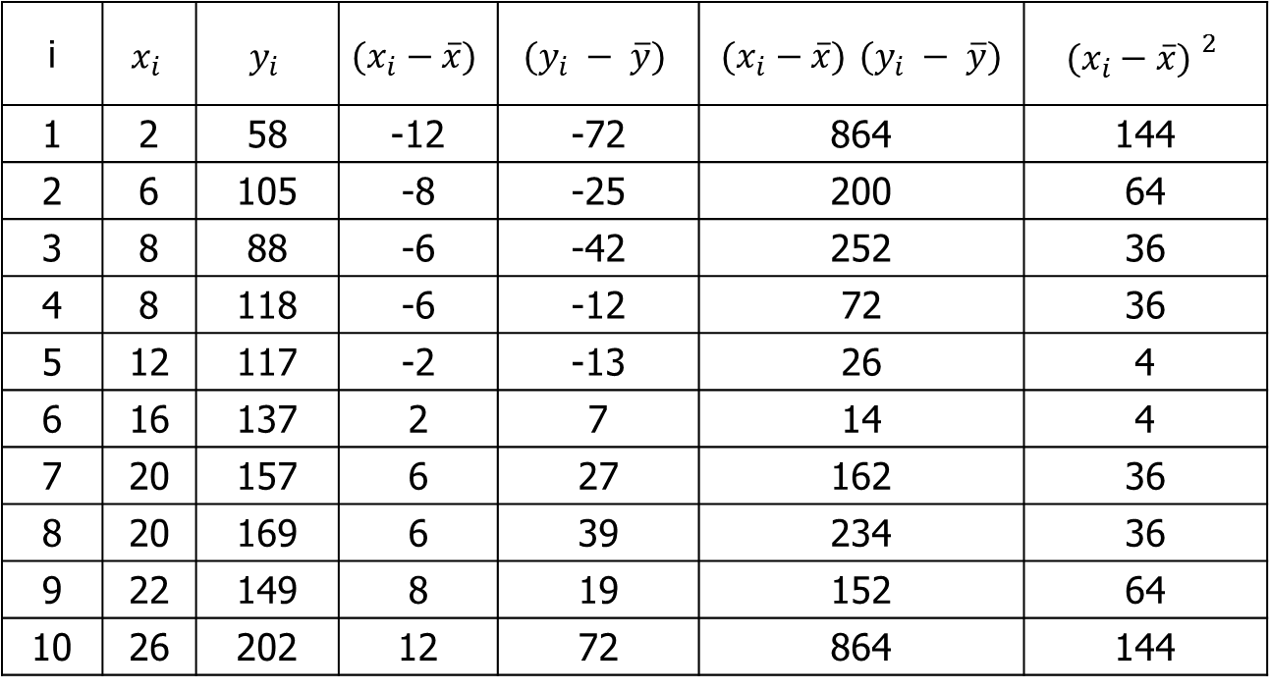
OLS Computation
i
1 | 2 | 58 | -12 | -72 | 864 | 144
2 | 6 | 105 | -8 | -25 | 200 | 64
3 | 8 | 88 | -6 | -42 | 252 | 36
4 | 8 | 118 | -6 | -12 | 72 | 36
5 | 12 | 117 | -2 | -13 | 26 | 4
6 | 16 | 137 | 2 | 7 | 14 | 4
7 | 20 | 157 | 6 | 27 | 162 | 36
8 | 20 | 169 | 6 | 39 | 234 | 36
9 | 22 | 149 | 8 | 19 | 152 | 64
10 | 26 | 202 | 12 | 72 | 864 | 144
Means 14 130 Totals 2840 568

Slide 24
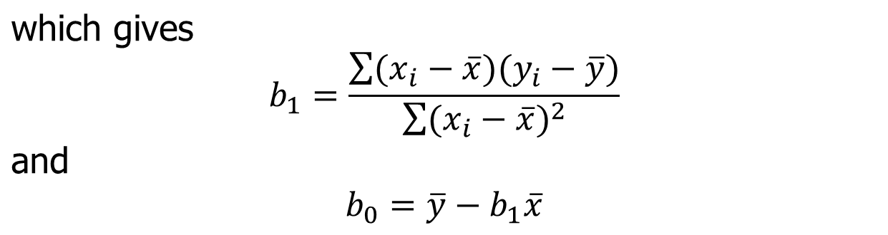
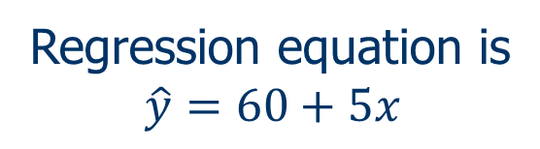
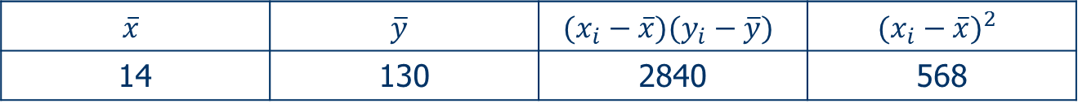
OLS Computation
14 | 130 | 2840 | 568
= 2840/568 = 5
= 130 – 5(14)= 60

Slide 25
Graph – Estimated Linear Regression

Slide 26
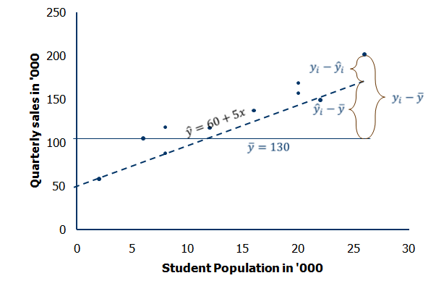
Graph of Deviations about Regression Line

Slide 27
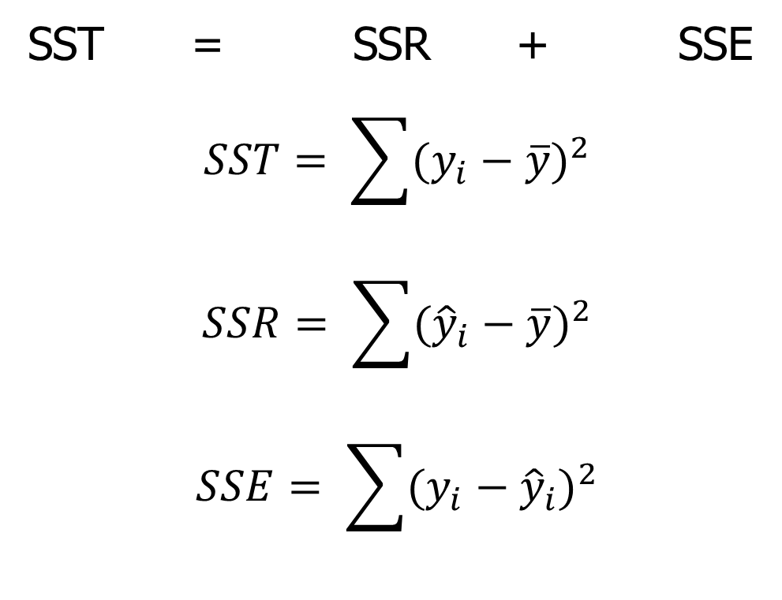
Sum of Square Equation

Slide 28
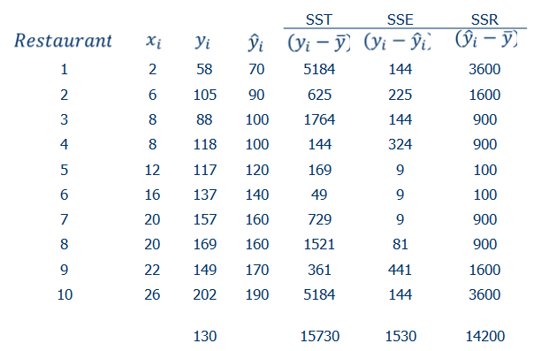
Sum of Square calculation

Slide 29
SS Calculation
SST = SSR + SSE
15730 = 14200 + 1530
Coefficient of Determination = r² = SSR/SST
= (14200/15730)
= 0.9027

Slide 30
Multi Linear Regression

Slide 31
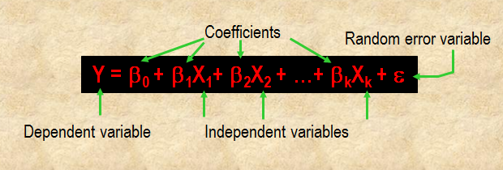
Multi Linear Regression
Multiple Regression is a statistical method for estimating the relationship between a dependent variable and two or more independent (or predictor) variables.
Predicting an outcome (dependent variable) based upon several independent variables simultaneously.

Slide 32
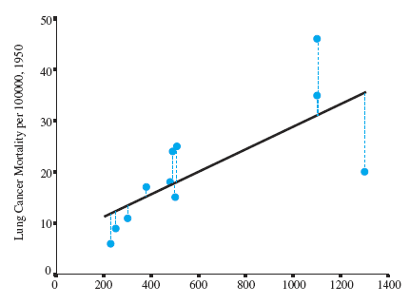
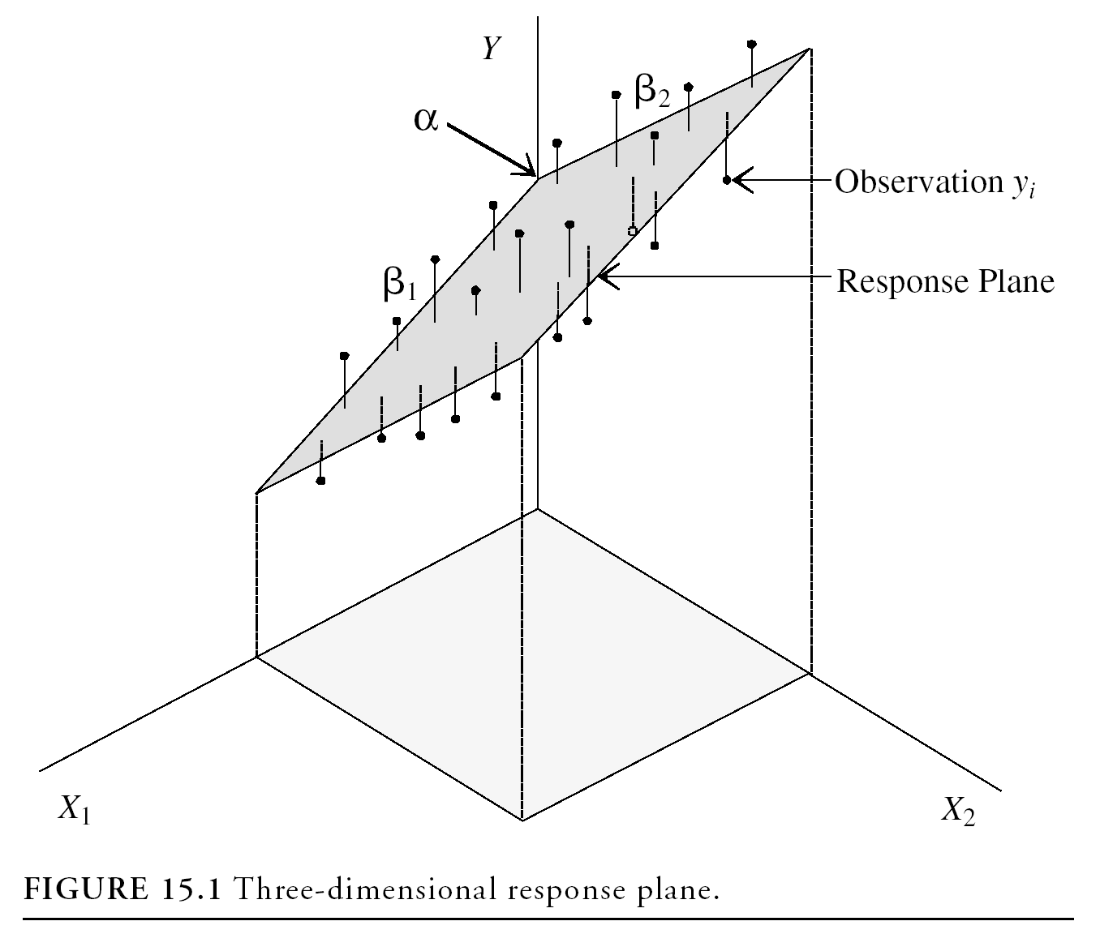
Regression Modeling
A simple regression model (one independent variable) fits a regression line in 2-dimensional space
A multiple regression model with two explanatory variables fits a regression plane in 3-dimensional space

Slide 33
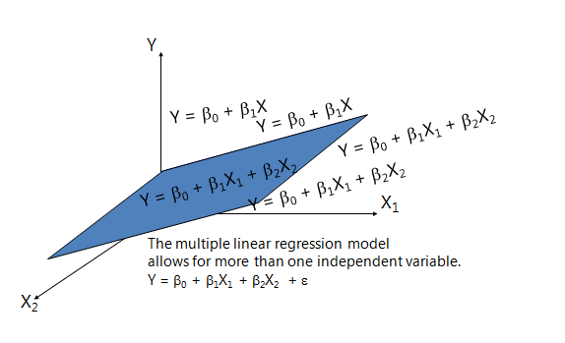
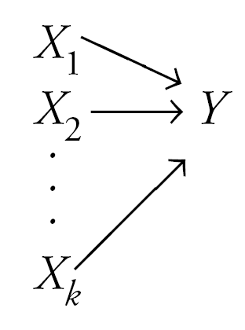
Multiple Regression for k = 2, Graphical Demonstration

Slide 34

Multi Linear Regression Model
For example, suppose that the effective life of a cutting tool depends on the cutting speed and the tool angle. A possible multiple regression model could be
where
Y – tool life
x₁ – cutting speed
x₂ – tool angle

Slide 35
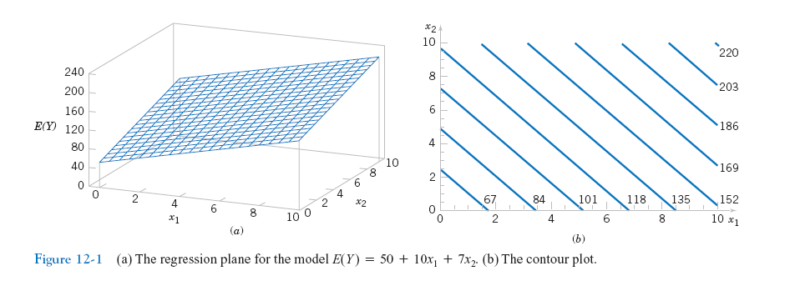
Multi Linear Regression
Figure 12-1
(a) The regression plane for the model E(Y) = 50 + 10x₁ + 7x₂.
(b) The contour plot

Slide 36
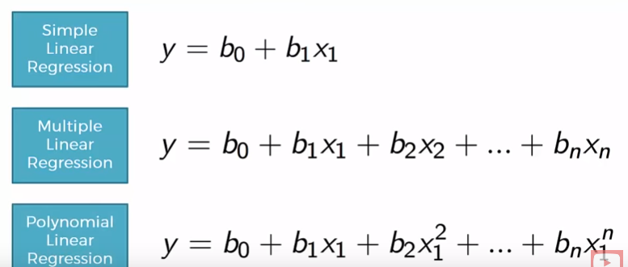
Regression
In Polynomial Linear regressions, variables are same as Multi linear but the powers are different

Slide 37
Linear Regression Models (Recap) -
The term "regression" generally refers to predicting a real number. However, it can also be used for classification (predicting a category or class.)
The term "linear" in the name “linear regression” refers to the fact that the method models data with linear combination of the explanatory variables.
A linear combination is an expression where one or more variables are scaled by a constant factor and added together.
In the case of linear regression with a single explanatory variable, the linear combination used in linear regression can be expressed as:
response = intercept + constant ∗ explanatory
In its most basic form fits a straight line to the response variable. The model is designed to fit a line that minimizes the squared differences (also called errors or residuals.).

Slide 38
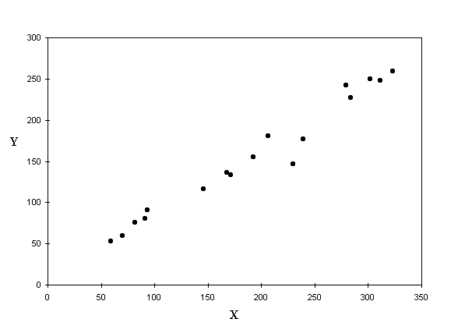
Linear Regression Models (Recap) -
Given Y = f(x) and the scatter plot shows apparent correlation between X and Y Let’s fit a line into the scatter which shall be our model
But there are infinite number of lines that can be fit in the scatter. Which one should we consider as the model?

Slide 39
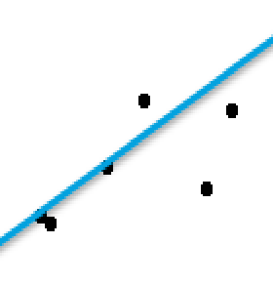
Linear Regression Models (Recap) -
Whichever line we consider as the model, it will not pass through all the points.
The distance between a point and the line (drop a line vertically (shown in yellow)) is the error in prediction
That line which gives least sum of squared errors is considered as the best line
Error = (T – (mx + C)
Sum of all errors can cancel out and give 0
We square all the errors and sum it up. That line which gives us least sum of squared errors is the best fit

